Slide 1
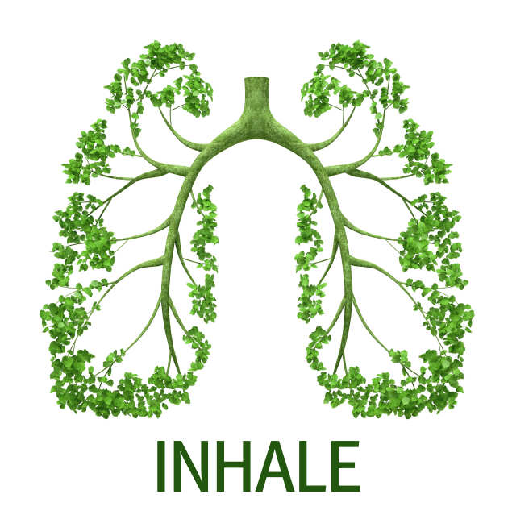

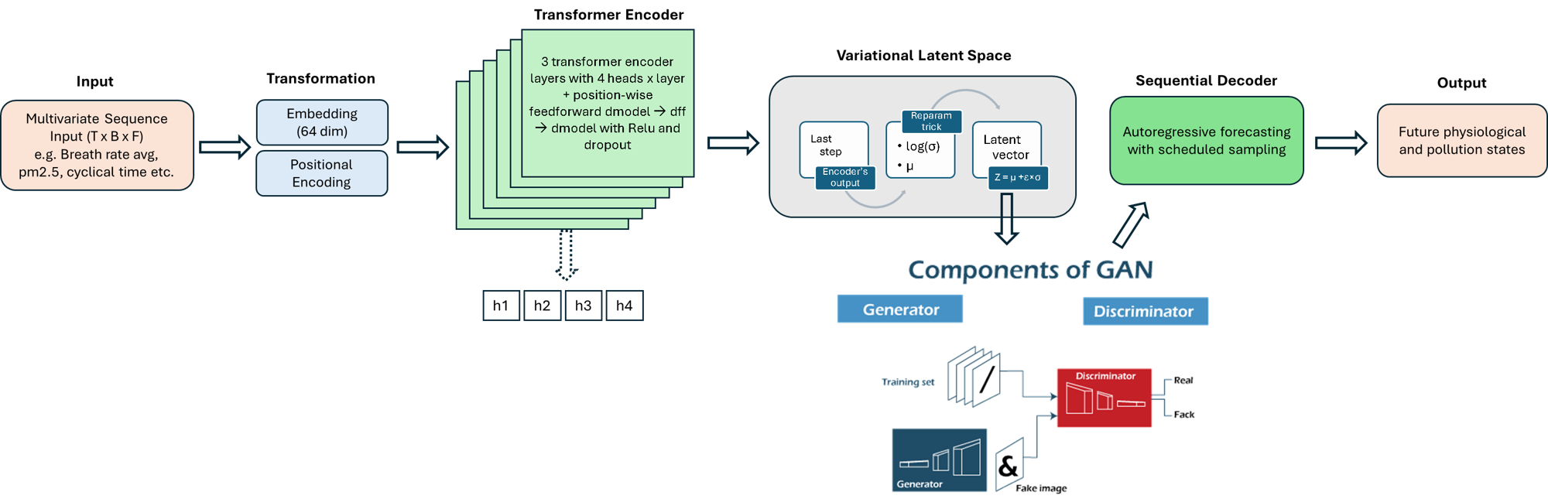
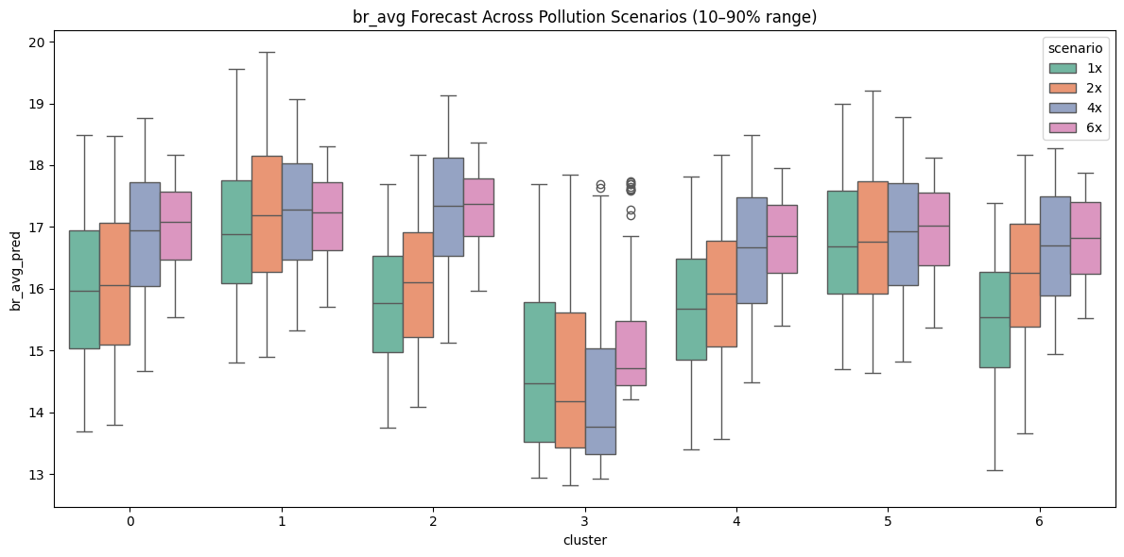
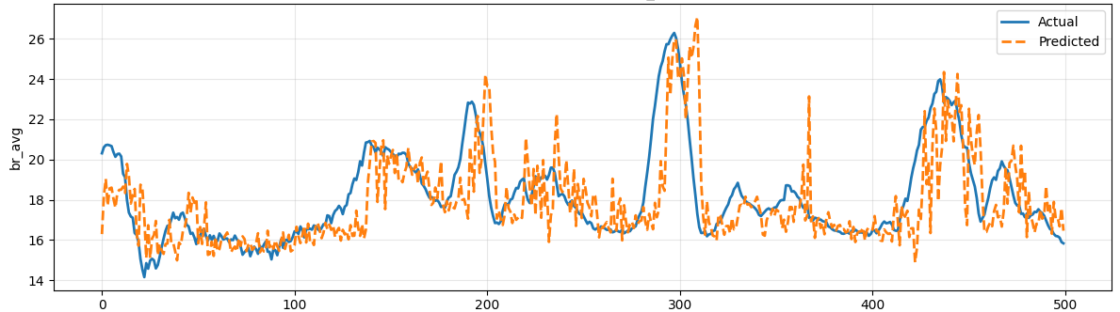
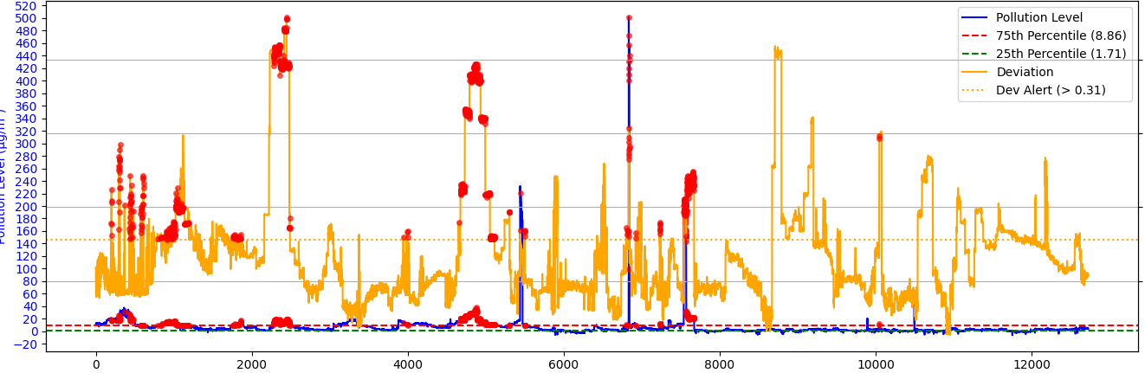
Predicting Individual Physiological Responses to Pollution Using Transformer-Based Time-Series Models
Abstract
Air pollution remains a major global health and environmental concern, contributing to an estimated seven million deaths annually because of the combined effects of outdoor and household exposure [1]. Simultaneously, advancements in wearable sensor technologies allow for the systematic collection of high-resolution physiological data over long periods of time [2].While recent research improved pollution forecast, there are gaps in understanding how these predictions affect individuals’ health. This study aims to develop an identity map linking varying levels of air pollution to individual physiological responses. Such a framework will enable the prediction of health responses to pollution exposure, facilitating early warnings and personalised health recommendations. To achieve this, we propose a two-model approach: an initial population model to capture general population temporal trends, and a personalised one specialised on individual characteristics. The population model is a transformer variational encoder–decoder, where the encoder captures long-term dependencies and the variational latent space supports in producing realistic decoding forecasts. The personalised model then adapts the population trends to unseen individual data. Our findings show not only that forecasting future hourly physiological states is feasible, but it also suggests that different patients are reactive to pollution. More sensitive ones can increase their breath rate to up to 10% when we increase pollution levels by six times.
Davide Baino, supervisors:
Christopher Pain
Boyang Chen
THE MODEL
Hybrid Transformer-Gan model for physiological and time-series forecasting
PERTURBATION
Breath rate forecast - reaction to different pollution scenarios
After running the dataset through the encoder, we found a latent space per patient.
We then grouped the patients in 7 clusters by similar reaction to pollution.
To understand how each of different clusters react to pollution we perturbed the dataset. Only pollution measures were multiplied respectively by 1 (baseline scenario), 2, 4 and 6 while other measures were left unchanged.
The results are quite evident, with each clusters increasing their breath rate average with some clusters reacting more than others (6 vs 1).
PERSONALISED
Breath rate average individual hourly forecast
The population model was fine-tuned to an additional individual.
Breath rate as an average was then forecasted hourly. The graph shows us the model was able to generalise and to understand new individual patterns.
Hourly Timestep
Alert risk system – Pollution level vs abnormal individual reaction
In blue pollution level, while in yellow deviation from normal state for individuals.
The alert system (the red dots) is active only when both pollution levels and reactions from individuals is abnormal.
Minute Timestep
References
World Health Organisation (2025). Overview.
Roos, L.G. & Slavich, G.M. (2023). Wearable Technologies for health research: Opportunities, limitations, and practical and conceptual considerations. Brain, Behavior, andImmunity, 113, 444–452. doi:10.1016/j.bbi.2023.08.008

